Slide 1
Individual identification using EEG signals while brain processing Arabic Speech
Impact Group

Slide 2
Individual identification
Presentation Overview
Introduction
Dataset
Preprocessing
CNN Model Architecture
Training & Evaluation
Result

Slide 3
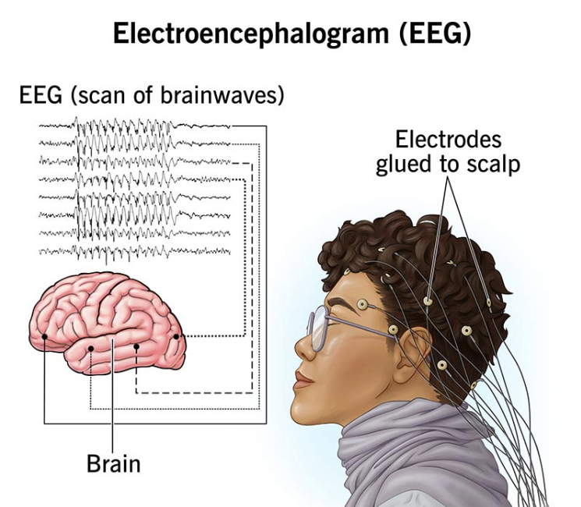
Individual identification
Introduction
EEG-based biometric identification has emerged as a promising alternative to traditional authentication methods. Unlike fingerprints or facial recognition, EEG signals originate directly from brain activity, making them extremely difficult to imitate or forge.
https://my.clevelandclinic.org/health/diagnostics/9656-electroencephalogram-eeg

Slide 4
Individual identification
2. Dataset
We used a publicly available EEG dataset recorded from 12 subjects, each imagining five Arabic words: Right, Left, Up, Down, and Calm.
For this project, we focused exclusively on the trials where subjects imagined the word “Right.”
Each subject has:
70 clean trials
8 EEG channels.
1200 time-samples per trial.
Each trial is represented as a single row containing the 8-channel EEG signal over the 1200 time points.

Slide 5



Individual identification
Every trial is stored as a row with 1200 timestamp values for each of the 8 EEG channels. After cleaning, we kept only true trials and removed fake or noisy data
And The data file already organize starting with subject 0 till 11

Slide 6
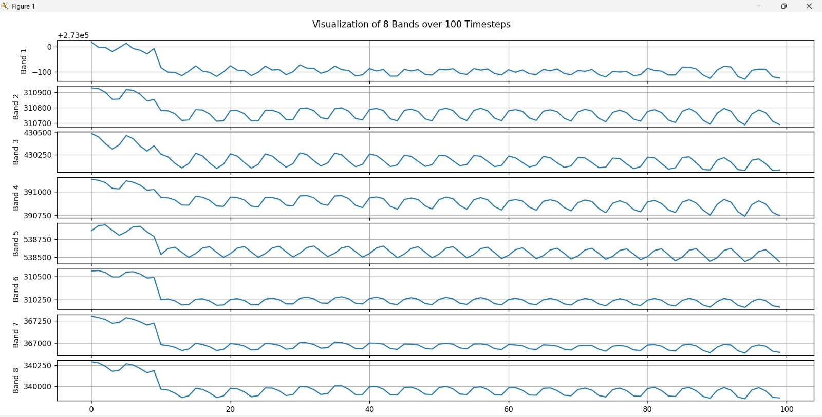
Individual identification
3. Data Preprocessing
Several preprocessing steps were applied to ensure clean, meaningful EEG signals.
Filtering:
Notch Filter (50/60 Hz): removes power-line noise.
Band-pass Filter (30–100 Hz): isolates the Gamma band, which is strongly linked to high-level cognitive processing and imagined speech.
Signal Enhancement:
DC Removal: stabilizes the signal baseline.
Z-Normalization: standardizes the amplitude across trials.

Slide 7
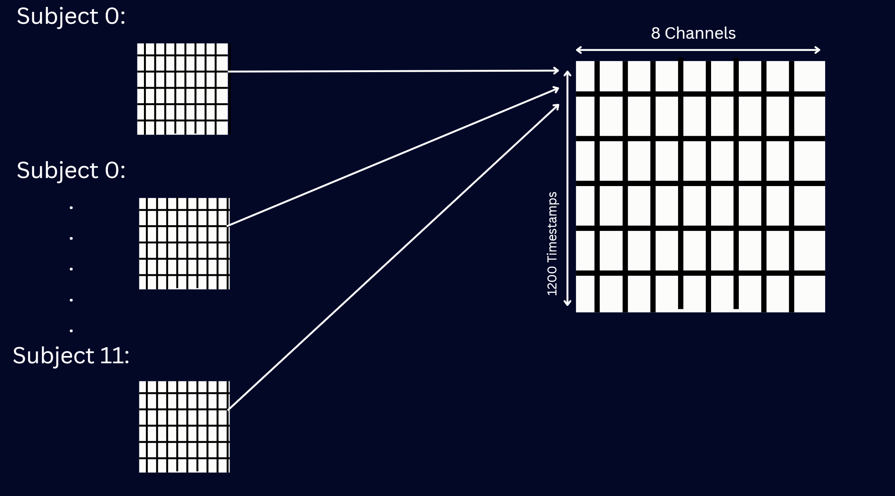
Individual identification
3. Data Preprocessing
Reshaping:
Each trial is reshaped into the form:
(1200 × 8 × 1) to match the expected input of the CNN model (time × channels × depth).
Data Splitting:
The dataset was divided as follows:
40 trials → Training
10 trials → Validation
20 trials → Testing
This ensures a balanced and fair evaluation of the model.

Slide 8
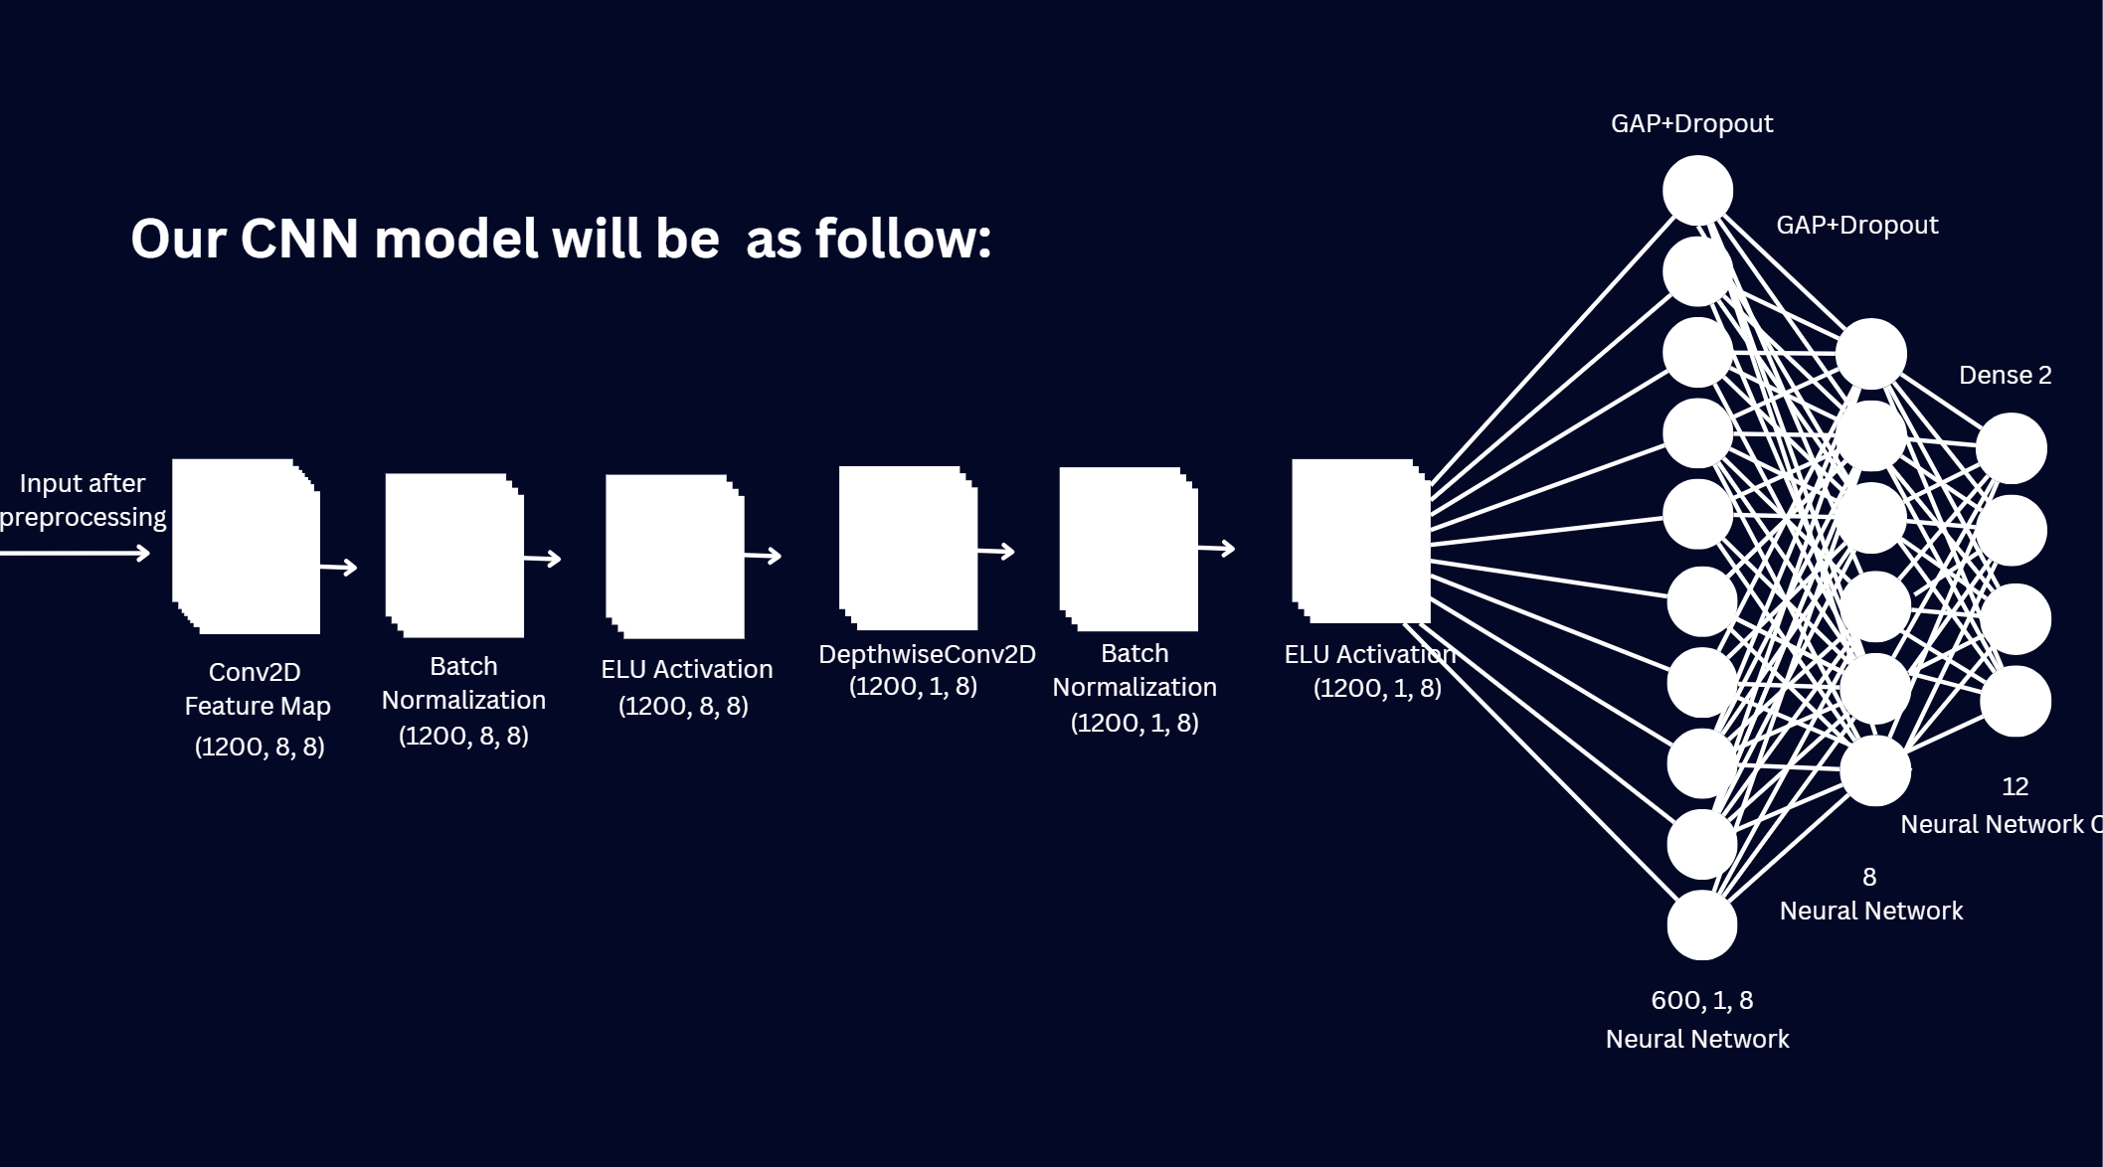
Individual identification
4. Methodology
The classification model is based on a Convolutional Neural Network (CNN) designed to extract both temporal and spatial patterns from EEG signals.
Temporal Feature Extraction:
A Conv2D layer with kernels spanning the time dimension learns frequency-based changes within each EEG channel independently.
Spatial Feature Extraction:
A Depthwise Convolution layer captures the relationships between channels by applying spatial filters across the eight EEG electrodes.

Slide 9
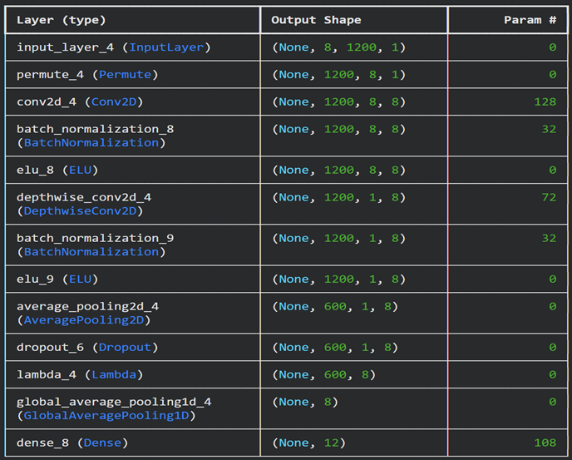
Individual identification
5. CNN Model
Temporal Convolution: learns time-based EEG patterns in each channel
Depthwise Spatial Convolution: captures relationships across EEG channels
ELU Activation: stabilizes learning and improves signal sensitivity
Pooling Layers: reduce dimensions and highlight dominant features
Global Average Pooling: compresses features from all channels
Dense Layer: final classification into 12 subjects

Slide 10
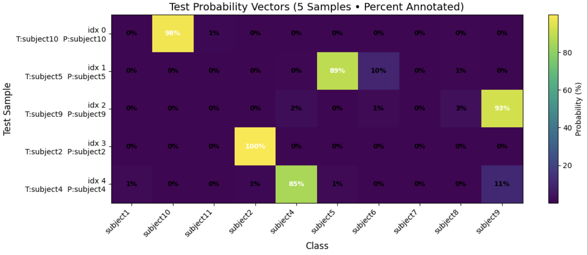
Individual identification
6. Result
In the testing phase, the model outputs a probability distribution for each test sample, which is then compared with the corresponding one-hot encoded target vector, as illustrated in the figure below.

Slide 11
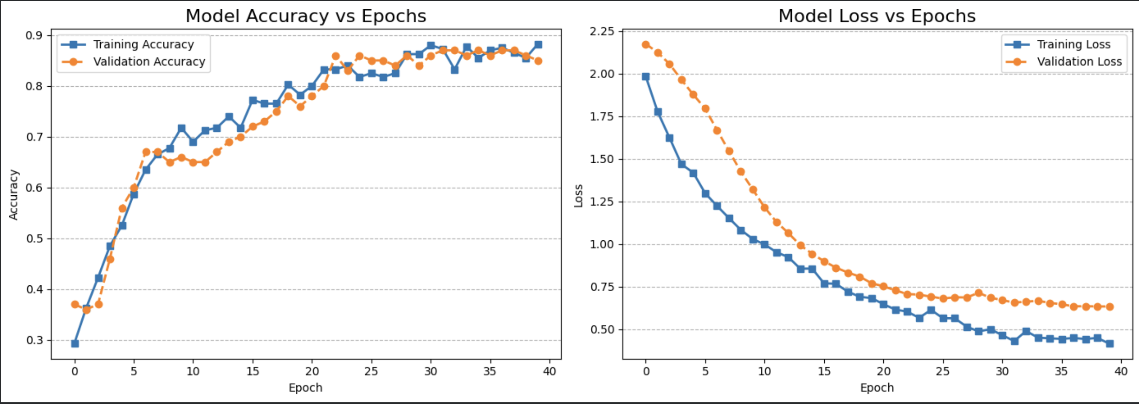
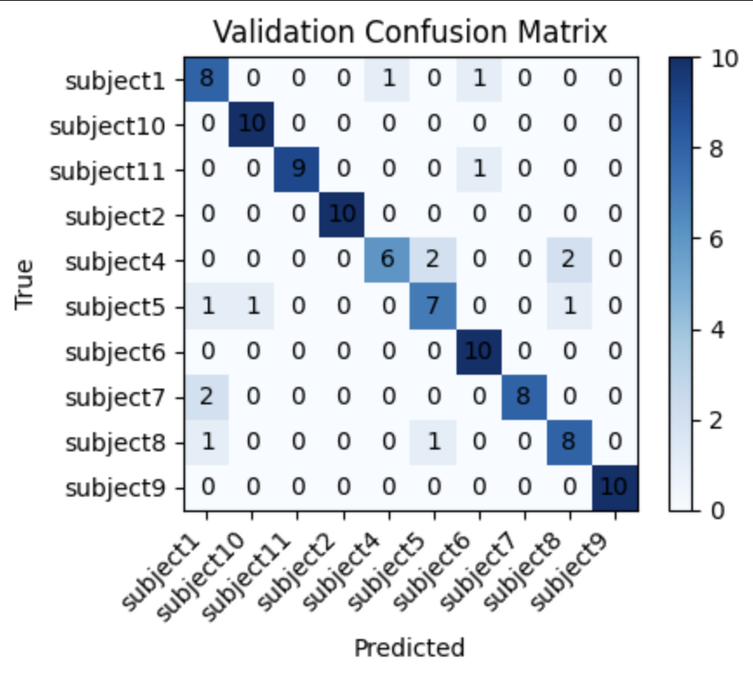
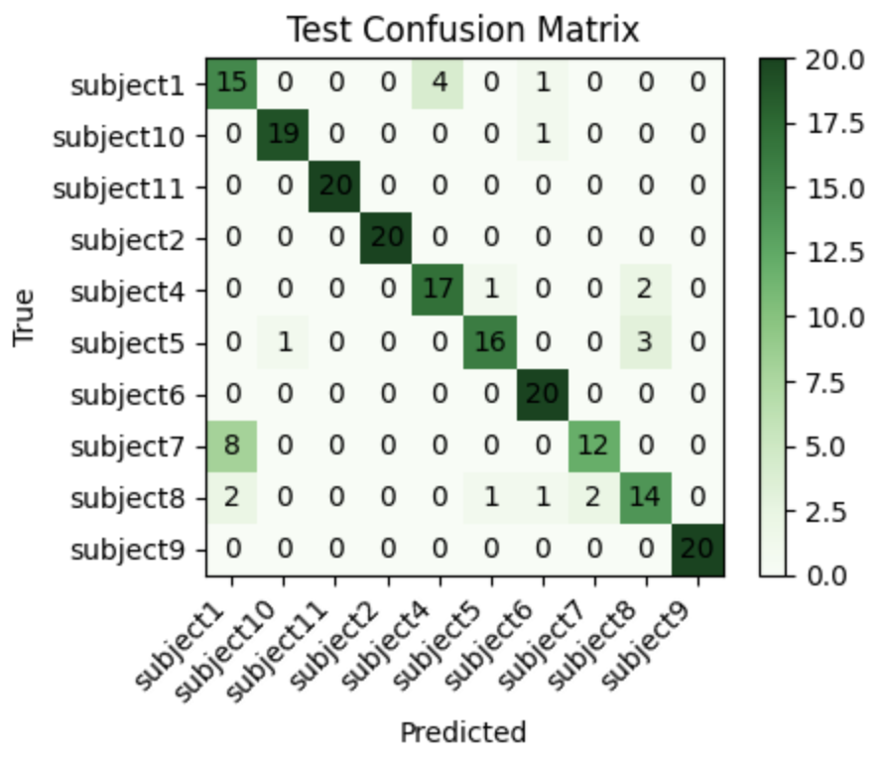
Individual identification
6. Result
Training Performance
The accuracy and loss curves show smooth convergence with no major signs of overfitting, indicating that the model generalizes well.
Final Test Accuracy
The model achieved:
86% final test accuracy Final loss: 0.51

Slide 12
Individual identification
7. Conclusion
Classification Analysis:
The classification report demonstrates:
High precision
Strong recall across most subjects
Good balance between classes
Minor misclassifications in a few neighboring subject classes
These results confirm that EEG signals, even for the same imagined word, contain unique neural signatures that can be used for identifying individuals.
These findings highlight the potential of EEG-based biometrics for future secure authentication systems and brain–computer interface applications.

Slide 13
Individual identification
Q&A

